Slide 1
Functions
Event driven units of code that can quickly solve problems

Slide 2
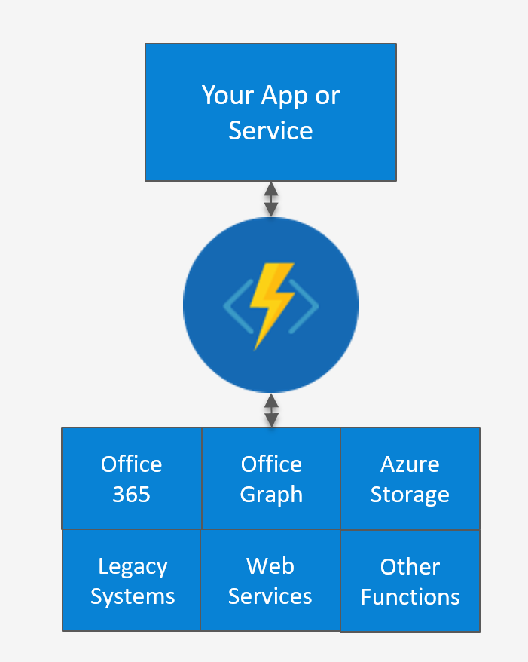
Common Scenarios
Timer-based processing
Azure service event processing
SaaS event processing
Serverless web apps
Serverless mobile
Real-time stream processing
Data processing
Real-time bot messaging

Slide 3
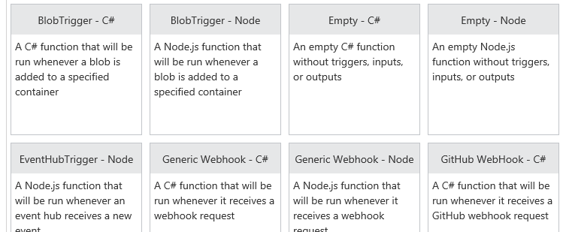
Function App templates
Notes:
BlobTrigger
EventHubTrigger
Generic webhook
GitHub webhook
HTTPTrigger
QueueTrigger
ServiceBusQueueTrigger
ServiceBusTopicTrigger
TimerTrigger
Blank & Experimental

Slide 4
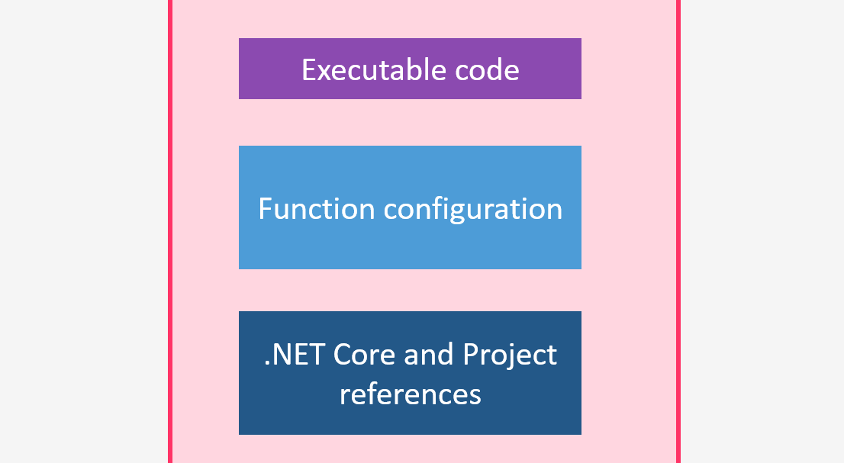
Anatomy of a Function
A “Run” file that containing the function code
A “Function” file contains service and trigger bindings and parameters
A “Project” file containing project assembly and package references
App Service settings, such as connection strings and API keys

Slide 5

Timer Function Apps
CRON expressions, like “0 */5 * * * *“ (every 5 minutes)
Great for redundant cleanup and data management
Great for checking state of services
Notes:
Martin Kearns Timer?

Slide 6
Demo: Timer

Slide 7

Webhook & API Function Apps
Triggered by events in other services, like GitHub
Often mimic Web API, Typically need CORS
Exposing functionality to other services, for building Logic Apps
Notes:
Webhook and API Functions are designed to easily integrate with 3rd party systems, like GitHub, Office 365, and especially Microsoft PowerApps. Since Webhook and API Functions are often exposed to external or legacy systems, they typically need CORS settings managed in order to “allow” external resources to “see” and execute the function. Most Azure Logic Apps leverage Webhook and API Functions directly.

Slide 8
DEMO: Github
Notes:
Creat a new function from a template. Call it via git hub.

Slide 9

Data Processing Function Apps
Run when triggered by item being added to a queue or container etc
In and Out
I used this last week at Shrewsbury Museum
Notes:
Data Processing Functions are triggered by activity in a datastore, such as a table, queue, or container. Data Processing Functions also typically have both “in” and “out” parameters, meaning they can accept an object as a parameter, and then process information and then return another object from within the function. This is not the same as a “return” value, as most Azure Functions either return void, or an HTTP response such as “created”, “accepted”, or “OK”.

Slide 10

Could you just go ahead add another Column to the database… that'd be great

Slide 11

No Problem
Change the code
Change the DB
Change Production

Slide 12
Please fold youR arms
Notes:
We don’t think we are set in our ways, but doing things differently can sometimes be a challenge.

Slide 13
Table Storage
Document DB
MSSQL or MySQL

Slide 14
! SCHEMA-LESS

Slide 15
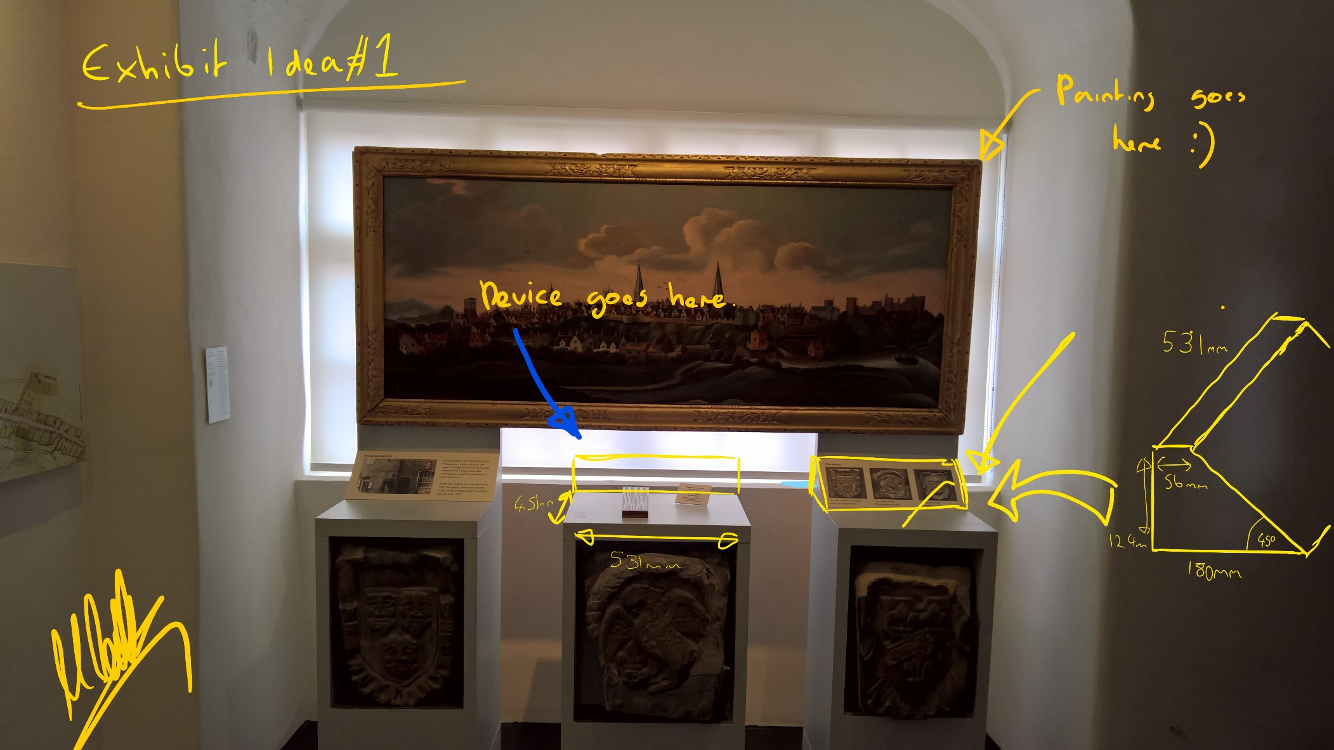

Demo : Shrewsbury MUseum

Slide 16
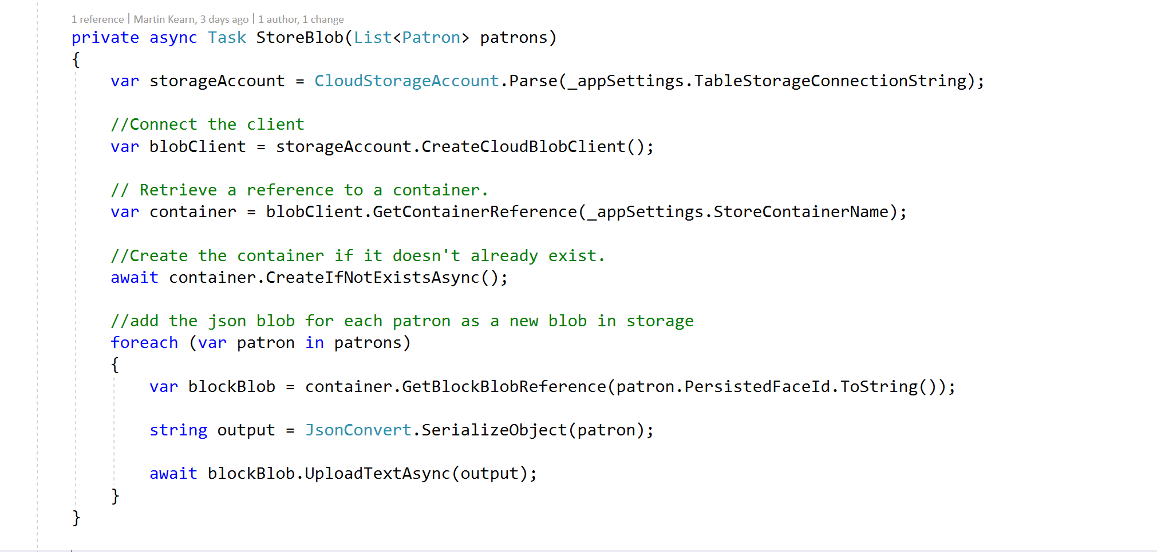
Yikes

Slide 17
No SQL = “no requirement for entity relationships and secondary indexing” in order to query information.

Slide 18
Terms Used
Permission
An authorisation token associated with a user for access to a specific resource.
Trigger
Application logic written in JavaScript executed before or after either an insert, replace or delete operation.
Database
A database is a logical container of document storage partitioned across collections. It is also a users container.
User
The logical namespace for scoping permissions.
Collection
A collection is a container of JSON documents and the associated JavaScript application logic.
Notes:
Most terms used in the context of Azure DocumentDB are similar, or at least conceptual similar to terms used in both object-oriented and relational database strategies, however the scope and design of certain elements differs in exact implementation. For example an Azure DocumentDB “Collection” can span multiple servers and partitions and are the primary entity of DocumentDB “groupings”. The terms “database” and “container” are often used synonymously, as the term database is more conceptual than physical.

Slide 19
Terms Used (Cont)
Stored Procedure
Application logic written in JavaScript which is registered with a collection and transactionally executed within the database engine.
User-defined Function
Application logic written in JavaScript. UDFs enable you to model a custom query operator and thereby extend the core DocumentDB query language.
Document
Arbitrary user-defined JSON content. By default, no schema needs to be defined nor do secondary indices need to be provided for all the documents added to a collection.
Notes:
Similar to the terms container and database, the DocumentDB term “document” is often confusing to new developers, as “document” more commonly means a “file-based” item, such as a PDF or Word document, Excel spreadsheet, PowerPoint slide deck, or even a text file. The term document in DocumentDB-speak is actually a JSON-based representation of data, and only optionally contains binary data. To get a better picture of what a document “looks like” in DocumentDB terms, imagine a single record from a relational database formatted as a JSON object. Although optional, attachments are also supported to store binary data.

Slide 20
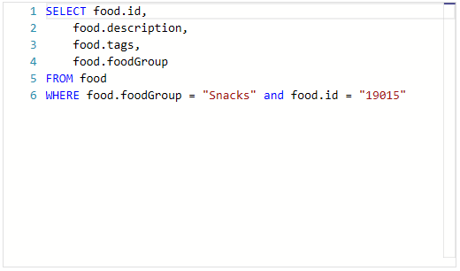
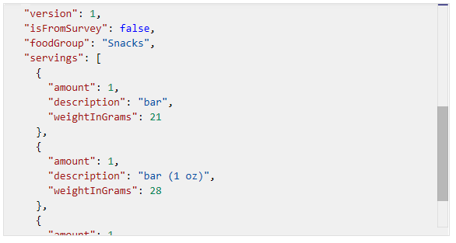
SQL over hierarchical JSON documents
SELECT, FROM, and WHERE statements
HAVING and ORDER BY statements
Full Geospatial and Geometry support, such as ST_DISTANCE
Notes:
Since DocumentDB is “schema-free” it provides automatic indexing of JSON documents without requiring explicit schema or creation of secondary indexes. If you’re familiar with legacy T-SQL or (Transactional Structured Query Language) commands you’ll be right at home querying DocumentDB content. Querying content typically consists or writing SELECT queries with option WHERE clauses and can be combined and joined across objects in the collection hierarchy.

Slide 21
Consistency Levels
Bounded
Guarantees that the writes are in order. Your reads will be consistent. Faster than strong
Eventual
This provides the weakest form of consistency. Reads might not be the latest values. You could even get data in the wrong order. E.g You save something and then read and get an old value. It’s the fastest.
Strong
A write transaction is only visible after its committed to all replicas. As such read/Write is slower
Session
Bound to the session of the client. So you get similar consistency to strong, but only for that session, other sessions may see different data.
Trade Off
Your Consistency Level is trade off between Performance and accuracy of data.
As with read requests, you can lower the consistency level of a specific query request by specifying the x-ms-consistency-level request header.

Slide 22
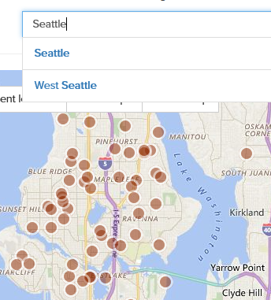
Azure Search
“delegated” cloud-based search
Ultra-high performing queries
Supports DocumentDB
Notes:
Add full text search. Azure Search can be integrated into your development ecosystems to add extremely performant search experience to any scenario, including web and mobile applications. Azure Search allows add a these experiences to your applications using a simple REST API or .NET SDK without managing search infrastructure or becoming an expert in search, and supports querying and indexing against all common datatypes and structures, including geospatial and mapping data.

Slide 23
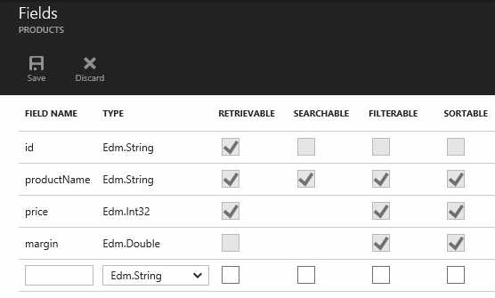
Azure Search Indexing
Can be managed at a granular level
Supports both rudimentary and extended datatypes
Can be managed programmatically
Notes:
The mechanism used by Azure Search to support ultra-fast querying is based on the concept of creating and managing indexes. An index is a persistent store of documents (and other constructs) identified by the Azure Search service. A document is a single unit of searchable data in your index. In Azure Search terminology, an index is conceptually similar to a table, and documents are roughly equivalent to rows in a table. Azure Search is often combined with support database storage mechanisms, such as SQL Server, Azure Blob Storage, and Azure DocumentDB to provide enhanced search experiences. Just as with Azure DocumentDB scenarios, Azure Search indexes and tuning can be managed via REST-ful HTTP calls or supported SDKs.

Slide 24
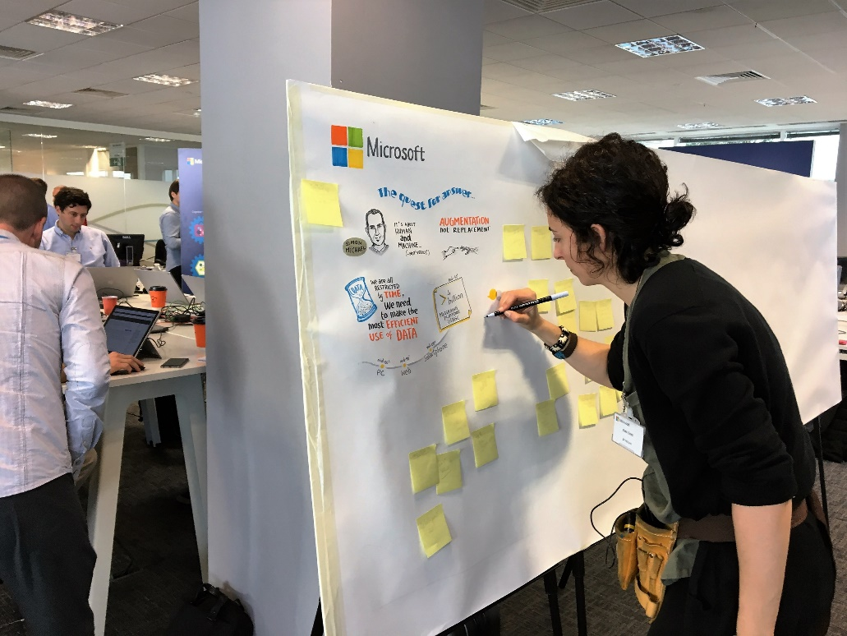
Language Support
JavaScript
C#
Python
PowerShell
PHP
Batch
Bash
Triggered by Azure Services

Slide 25
Bindings
Type | Service | Trigger | Input | Output
Schedule | Azure Functions | ✔
HTTP (REST or webhook) | Azure Functions | ✔ |  | ✔*
Blob Storage | Azure Storage | ✔ | ✔ | ✔
Events | Azure Event Hubs | ✔ |  | ✔
Queues | Azure Storage | ✔ |  | ✔
Tables | Azure Storage |  | ✔ | ✔
Tables | Azure Mobile Apps |  | ✔ | ✔
No-SQL DB | Azure DocumentDB |  | ✔ | ✔
Push Notifications | Azure Notification Hubs |  |  | ✔

Slide 26
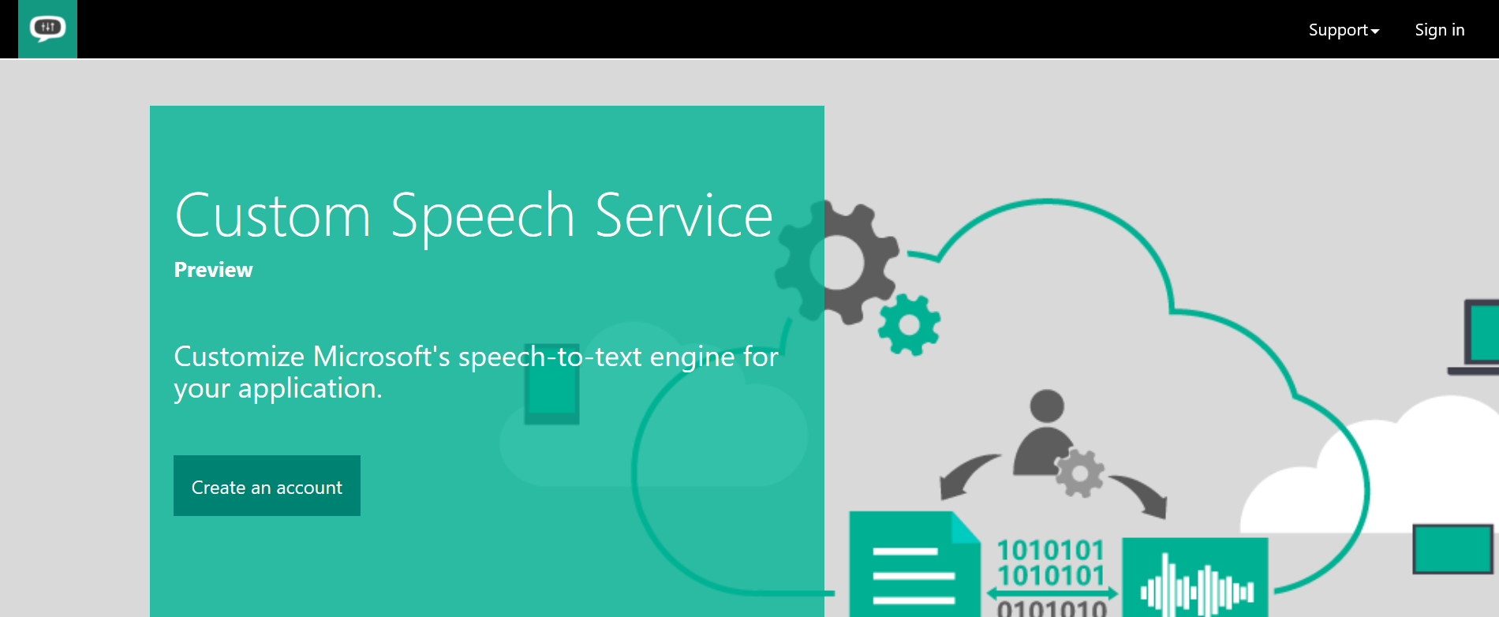
DEMO: Plexus Law

Slide 27

DEMO: Want to build a bot?

